Slide 1
Bluetooth Wireless Ad-hoc Network
Presented by
Bluetooth Group

Slide 2
รายชื่อผู้ร่วมงาน
นส.ศักดิ์สุตา ฉันทเตยานนท์ รหัส 41014416
นายสิทธิชัย เผือกวัฒนะ รหัส 41014459
นส.สุญาดา อาจไชยชาญ รหัส 41014471
Bluetooth Wireless Ad-hoc Network

Slide 3
Scope
To develop device manager in ad-hoc network by implement on Bluetooth protocol stack.

Slide 4
Objective
Demonstrate ad-hoc network via Bluetooth.
Increment ability in device and service
management.
Make protocol stack to be useful.
Study the structure of Bluetooth protocol
stack.

Slide 5
How is it to be interested?
To study technology that is a trend.
Develop the main feature of Bluetooth.
Apply knowledge.
Challenging.

Slide 6
Process
Study Bluetooth protocol stack in each layers.
Specific necessary layers and study in depth.
Finding suitable protocol stack.
Study structure and algorithm.
Design function and interface.
Coding and debugging.
Iterative and incremental development.

Slide 7
Agenda
Bluetooth Technology
Bluetooth Position
Scenario
Bluetooth Wireless Ad-hoc Network
Summary

Slide 8

Bluetooth Technology

Slide 9

What is Bluetooth?
A unique new wireless technology specifically for:
Short range
  Up to 10 meters typically
  Using 2.4 GHz (ISM band)
Dynamic configurability
  i.e. ad hoc networking/roaming
Low power
  Well suited to handheld applications
Support for both voice and data
Notes:
Bluetooth is extremely unique among wireless technology alternatives in a number of key ways as outlined above. While Bluetooth’s technical specs. are modest in comparison to other technologies they are acceptable for almost every application except high quality video, and are key to achieving low cost. The combination of low cost and Bluetooth’s unique functional capabilities position the technology to enable many new and innovative markets and applications, thus making it one of the highest volume emerging wireless application opportunities.

Slide 10

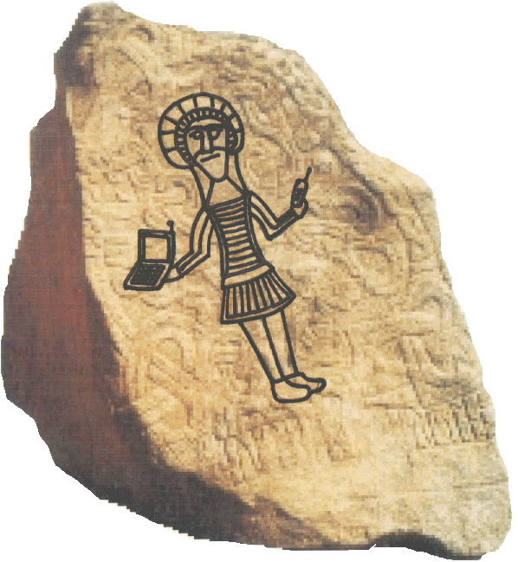
Who was Bluetooth?
Ericsson, the principal inventor, borrowed the name from Harald Bluetooth (son of Gorm)
  The King of Denmark circa 900AD
  United Denmark and Norway
Seemed like a good name for uniting many dissimilar devices from different manufacturers

Slide 11
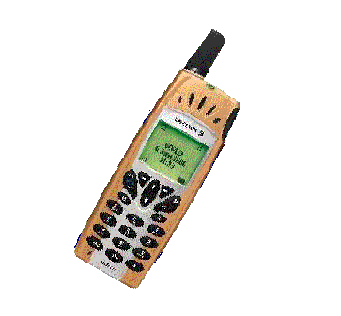

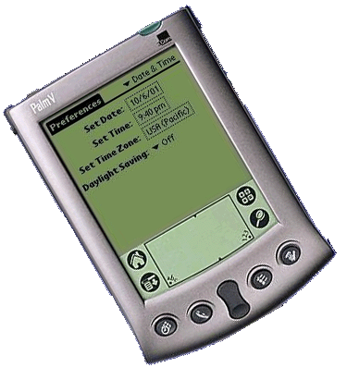


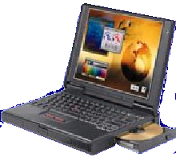
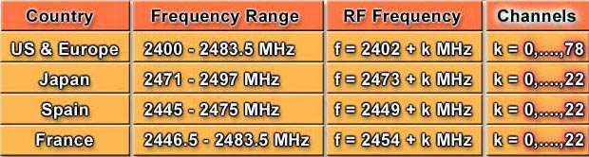
Frequency Band
Using ISM band at 2.4 GHz
(Industrial Scientific and Medical)

Slide 12



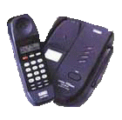
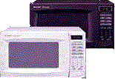
Interference

Slide 13
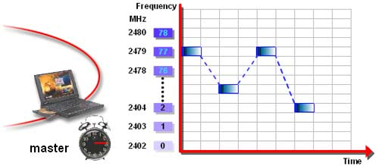
Frequency Hopping

Slide 14
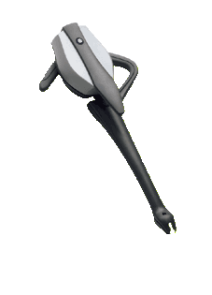
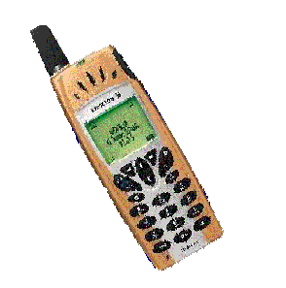
Physical Link
SCO (Synchronous Connection Oriented)
ACL (Asynchronous Connectionless)
SCO link
ACL link

Slide 15
Data Rate
Type
Upstream
Data Rate
Downstream
Data Rate
3 simultaneous
voice channel
64 Kb/s*3 channels
64 Kb/s*3 channels
Symmetric Data
433.9 Kb/s
433.9 Kb/s
Asymmetric Data
723.2kb/s,
57.6 Kb/s
57.6 Kb/s,
723.2 Kb/s

Slide 16
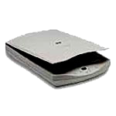
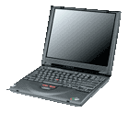
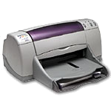
Topology
Piconet
Scatternet
Slave2
Slave3
Slave1
Slave4
Master

Slide 17

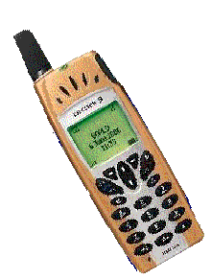


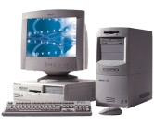

Piconet
Slave1
Slave1
Slave2
Piconet
Piconet
Master
Master
Slave1
Piconet
Slave3
Master

Slide 18

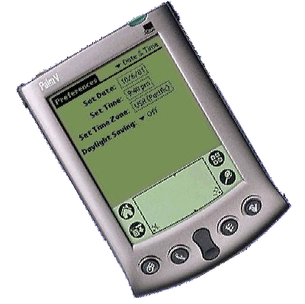
Scatternet
Piconet - A
Piconet - B
Slave 2
Slave 1
B/W Master
Color Master
Slave 1
Scatternet
Piconet - A
Piconet - B
Slave 2
Slave1
Master
Master
Slave 1
Scatternet

Slide 19
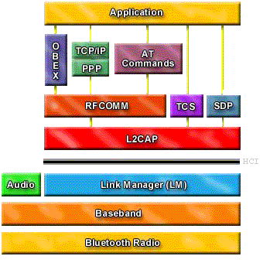
Bluetooth protocol stack
Object
Exchange
Telephony Control Protocol
Bluetooth Host
Service Discovery Protocol
Logical Link Control and
Adaptation Protocol
Host Controller Interface
(HCI)
HCI
Bluetooth Module

Slide 20

Bluetooth Position

Slide 21


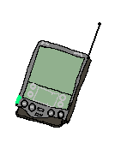
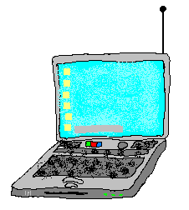


Wireless Positioning
Wireless LAN
On-campus: Office, School, Airport, Hotel, Home
Bluetooth
Person Space: Office, Room, Briefcase, Pocket, Car
Cellular
Off-Campus Global Coverage

Slide 22

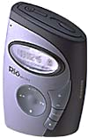
What is Bluetooth Good For?
No Wires!
  In the home
  On the move
Personal Area Networking (PAN)
  Enabling a collection of YOUR personal devices to cooperatively work together
Notes:
Bluetooth was originally conceived to replace the rat’s nest of cables typical in any PC setup today and this remains a compelling home application.
However, as the Bluetooth evolved it became clear that it would also enable a totally new networking paradigm, Personal Area Networks (PANs)! With PAN technology a user will be able to organize a collection of personal electronic products (their PDA, cell phone, laptop, desktop, MP3 player, etc.) to automatically work together. For instance the contact manager and calendar in the PDA, laptop, and desktop could all automatically synchronize whenever they are within range of each other). Over time PANs will revolutionize the user experience of consumer electronics.
Finally, Bluetooth’s dynamic nature will also revolutionize connectivity to the rest of the world. Bluetooth will automatically discover devices and services nearby so available servers, internet access, printers etc. will automatically become visible to a Bluetooth device wherever it is.

Slide 23
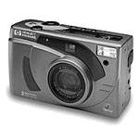
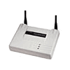
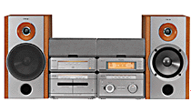
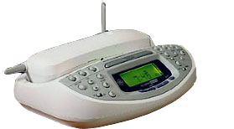
Bluetooth in PAN
Digital Camera
Computer
Scanner
Inkjet
Printer
xDSL
Access Point
Home Audio System
PDA
Cell Phone
Cordless Phone
Base Station
MP3
Player
Notes:
Bluetooth in the home will ultimately eliminate most every cable related to consumer electronics (except power). Your PC, scanner, and printer will simply need to be within 10 meters of each other in order to work. Your PDA, digital camera, and MP3 player will no longer need a docking station to transfer files or get the latest tunes (the exception will be to recharge, that power thing again). And, your home stereo and other equipment will join the party too.
On the telephone front your cell phone will synchronize its address book with your PC and function as a handset to your cordless phone in the house (answering incoming calls to your home number and calling out on the cheaper land line too).
Finally, even though its only 720Kbps, Bluetooth is still pretty fine for broadband internet access since DSL and cable modems are typically throttled to about 384K anyway. Bluetooth access points could well be as ubiquitous as 56K modems in 2 or 3 years.

Slide 24



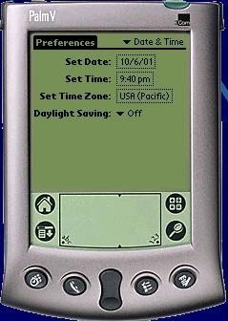
Bluetooth Objective
Wireless link between all mobile devices

Slide 25
Scenario

Slide 26






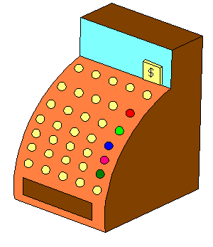


Bluetooth Vision
Universal Data/Voice Access Points
Cable Replacement
Personal Ad-hoc Networks

Slide 27
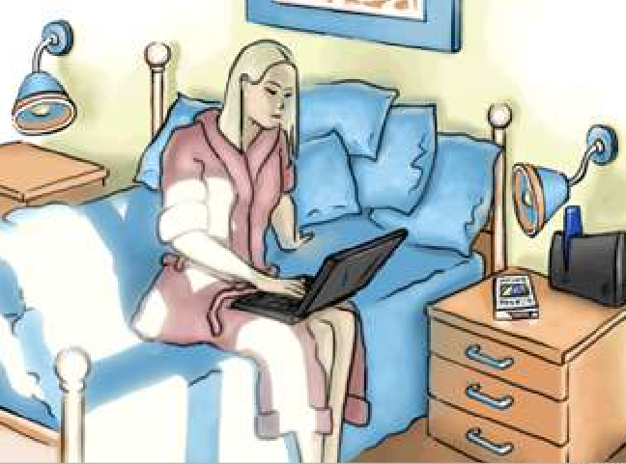
“Sofa surfing”: check e-mail, browse internet cord-free

Slide 28
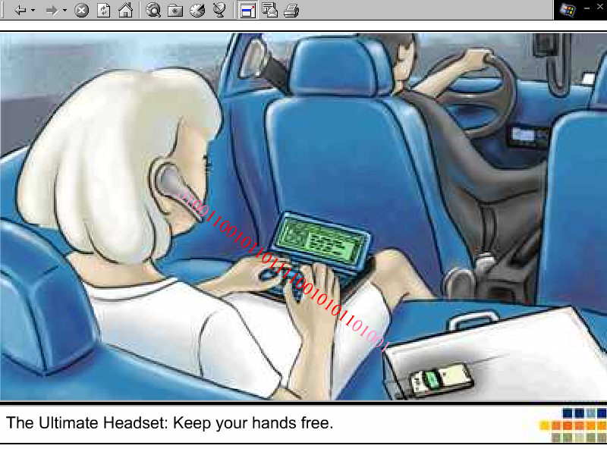
Ultimate headset phone: Keep hands free.

Slide 29
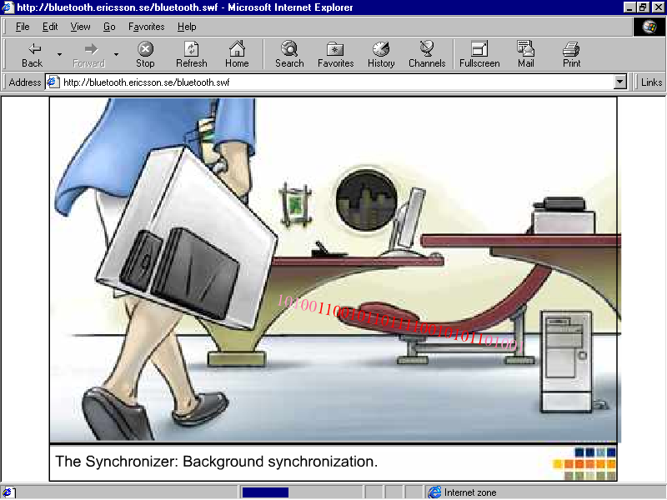
Background synchronization: update between phone, laptop, PC

Slide 30
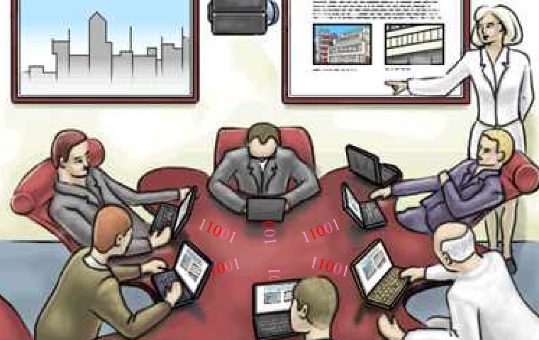
Share and exchange data in meetings.
Bluetooth creates ad hoc networks.

Slide 31
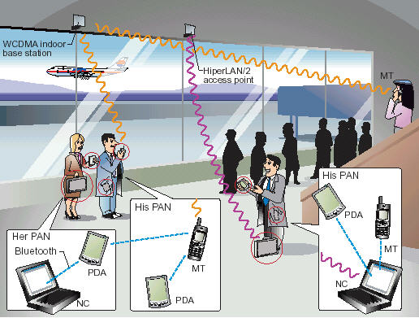
Ad-hoc network

Slide 32
Bluetooth Wireless Ad-hoc Network

Slide 33
Initiate ad-hoc via Bluetooth
Find Bluetooth devices (Inquiry)
Initiate connection (Page)
Service Discovery (SDP)
Inquiry
Inquiry
Inquiry
Page
Page
Page
Service Discovery

Slide 34
Finding Bluetooth devices
ID
ID
FHS
Inquiry

Slide 35
Initiate Connection
ID
ID
FHS
POLL
NULL
Page

Slide 36
Service Discovery
Baseband Paging
Procedures Set Up ACL Link
Set up L2CAP connection
Set up SDP connection
Service search attribute request
Return attributes service
Service Discovery

Slide 37
Summary
Study Bluetooth protocol stack in each layers.
Specific necessary layers and study in depth.
Finding suitable protocol stack.
Study structure and algorithm.
Design function and interface.
Coding and debugging.
Iterative and incremental development.

Slide 38
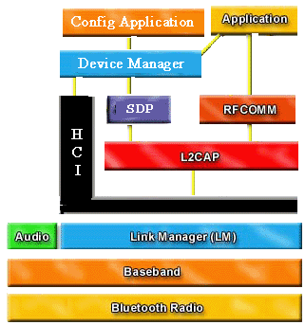
Summary
Device and Service
Management
Bluetooth Host
Bluetooth Module

Slide 39
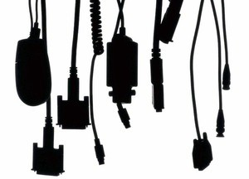
The End
Bye-bye WIRE !!!

